Slide 1
Chapter 6: Process Synchronization

Slide 2
Chapter 6: Process Synchronization
Background
The Critical-Section Problem
Consumer-Producer problems
Peterson’s Solution
Synchronization Hardware
Semaphores
Classic Problems of Synchronization
Monitors
Synchronization Examples
Atomic Transactions

Slide 3
Objectives
To introduce the critical-section problem, whose solutions can be used to ensure the consistency of shared data
To present both software and hardware solutions of the critical-section problem
To introduce the concept of an atomic transaction and describe mechanisms to ensure atomicity

Slide 4
Background
Concurrent access to shared data may result in data inconsistency
Maintaining data consistency requires mechanisms to ensure the orderly execution of cooperating processes
Suppose that we wanted to provide a solution to the consumer-producer problem that fills all the buffers. We can do so by having an integer count that keeps track of the number of full buffers. Initially, count is set to 0. It is incremented by the producer after it produces a new buffer and is decremented by the consumer after it consumes a buffer.

Slide 5
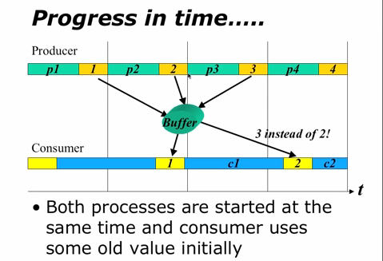
Typical problems of IPC
Producer-Consumer problem is an ideal problem of the IPC
Producer did not produce but consumer needs to consume
The buffered is shared (a shared variable from the shared buffer)

Slide 6
Producer & Consumer
Producer
Consumer
while (count == 0)
; // do nothing
// remove an item from the buffer item = buffer[out];
out = (out + 1) % BUFFER.SIZE;
--count;
while (count == BUFFER.SIZE)
; // do nothing
// add an item to the buffer buffer[in] = item;
in = (in + 1) % BUFFER.SIZE;
++count;

Slide 7
Race Condition
count++ could be implemented as
register1 = count
register1 = register1 + 1
count = register1
count-- could be implemented as
register2 = count
register2 = register2 - 1
count = register2
Consider this execution interleaving with “count = 5” initially:
  T0: producer execute register1 = count {register1 = 5}
  T1: producer execute register1 = register1 + 1 {register1 = 6}
  T2: consumer execute register2 = count {register2 = 5}
  T3: consumer execute register2 = register2 - 1 {register2 = 4}
  T4: producer execute count = register1 {count = 6 }
  T5: consumer execute count = register2 {count = 4}

Slide 8
A Race Condition
Because of the timing and which process start first
One process at a time can read some mutually exclusive data
The mutually exclusive area is called the critical section
  A section of code in which the process accesses and modifies shares variables
A method of preventing critical section is by mutual exclusion

Slide 9
Why process need to communicate
To synchronize their execution
To exchange data and information
Rules to form a critical section
No two processes may be simultaneously inside their CS
No assumptions are made about relative process speed or number of CPU’s
A process outside a CS should not block other processes
No process should be able to wait forever before entering its CS

Slide 10
Problem of mutual exclusion
Starvation
  Indefinitely delaying the scheduling of a process in favour of another process
  If a scheduling algorithm is bad, there is a bias so aging may occur
  The solution may be the multilevel scheduling queue (as done in the last lecture)
Deadlocks
  Two or more processes are blocked waiting for an event that will never occur
  A waits for B to do something and B is waiting for A
  Both are waiting not doing anything for other
  Solution – kill one of the processes (a low priority)

Slide 11
Solution to Critical-Section Problem
Mutual Exclusion - If process P_{i} is executing in its critical section, then no other processes can be executing in their critical sections.
Progress - If no process is executing in its critical section and there exist some processes that wish to enter their critical section, then the selection of the processes that will enter the critical section next cannot be postponed indefinitely.
Bounded Waiting - A bound must exist on the number of times that other processes are allowed to enter their critical sections after a process has made a request to enter its critical section and before that request is granted.
  Assume that each process executes at a nonzero speed
  No assumption concerning relative speed of the N processes

Slide 12
How to implement Mutual Exclusion
There are three possibilities
  Application – programmers builds some method into the program
  OS/Programmers – Provide some services that can be used by the programmers
  Hardware – special hardware instructions provided to implement ME (faster)

Slide 13
Critical Section Problem Solution
Algorithm
  Peterson's Algorithm: based on busy waiting
Software Solution
  Semaphores: general variable facility provided by operating system (e.g., OS/2)
    based on low-level techniques such as busy waiting or hardware assistance
  Mutex : Variable
  Monitors: programming language technique
  see S&G, pp. 190--197 for more details
Hardware Solution
    Exclusive access to memory location
    Interrupts that can be turned off
    must have only one processor for mutual exclusion
  Test-and-Set: special machine-level instruction
  Swap: atomically swaps contents of two words
  for example, the Exchange instruction is available in the machine language used on Intel processors.

Slide 14
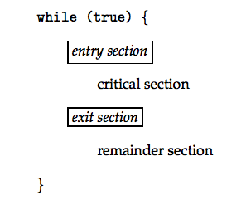
Structure of a Typical Process

Slide 15
ALGORITHM SOLUTION

Slide 16
Peterson’s Solution
Two process solution
Assume that the LOAD and STORE instructions are atomic; that is, cannot be interrupted.
The two processes share two variables:
  int turn;
  boolean flag[2]
The variable turn indicates whose turn it is to enter the critical section.
The flag array is used to indicate if a process is ready to enter the critical section. flag[i] = true implies that process P_{i} is ready!

Slide 17
Algorithm for Process P_{i}
while (true) {
flag[i] = true;
turn = j;
while (flag[j] && turn == j);
critical section
flag[i] = false;
remainder section
}

Slide 18
Solution to Critical-Section Problem
Using Locks
while (true) {
acquire lock
critical section
release lock
remainder section
}

Slide 19
HARDWARE SOLUTION

Slide 20
Synchronization Hardware
Many systems provide hardware support for critical section code
Uniprocessors – could disable interrupts
  Currently running code would execute without preemption
  Generally too inefficient on multiprocessor systems
    Operating systems using this not broadly scalable
Modern machines provide special atomic hardware instructions
    Atomic = non-interruptable
  Either test memory word and set value
  Or swap contents of two memory words

Slide 21
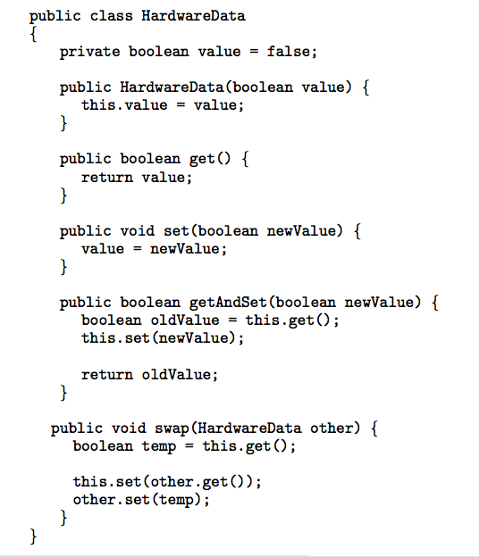
Data Structure for Hardware Solutions

Slide 22
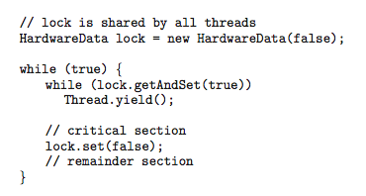
Solution using GetAndSet Instruction

Slide 23
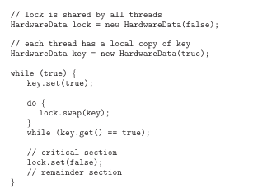
Solution using Swap Instruction

Slide 24
OS/SOFTWARE SOLUTION

Slide 25
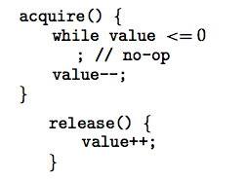
Semaphore
Synchronization tool that does not require busy waiting
Semaphore S – integer variable
Two standard operations modify S: acquire() and release()
  Originally called P() and V()
Less complicated
Can only be accessed via two indivisible (atomic) operations

Slide 26
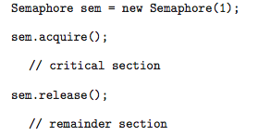
Semaphore as General Synchronization Tool
Counting semaphore – integer value can range over an unrestricted domain
Binary semaphore – integer value can range only between 0
and 1; can be simpler to implement
  Also known as mutex locks

Slide 27
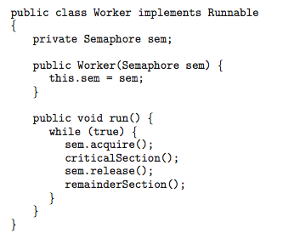
Java Example Using Semaphores

Slide 28
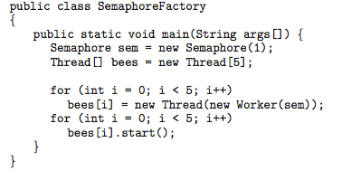
Java Example Using Semaphores

Slide 29
Semaphore Implementation
Must guarantee that no two processes can execute acquire () and release () on the same semaphore at the same time
Thus, implementation becomes the critical section problem where the wait and signal code are placed in the critical section.
  Could now have busy waiting in critical section implementation
    But implementation code is short
    Little busy waiting if critical section rarely occupied
Note that applications may spend lots of time in critical sections and therefore this is not a good solution.

Slide 30
Semaphore Implementation with no Busy waiting
With each semaphore there is an associated waiting queue. Each entry in a waiting queue has two data items:
  value (of type integer)
  pointer to next record in the list
Two operations:
  block – place the process invoking the operation on the appropriate waiting queue.
  wakeup – remove one of processes in the waiting queue and place it in the ready queue.

Slide 31
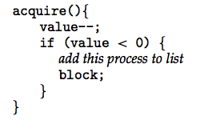
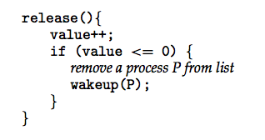
Semaphore Implementation with no Busy waiting (Cont.)
Implementation of acquire():
Implementation of release():

Slide 32
CLASSICAL IPC PROBLEMS

Slide 33
Classical Problems of Synchronization
Bounded-Buffer Problem for producer/Consumer
Bank problem – insert/delete or produce/consume
Readers and Writers Problem
Dining-Philosophers Problem

Slide 34
Bounded-Buffer Problem
N buffers, each can hold one item
Semaphore mutex initialized to the value 1
Semaphore full initialized to the value 0
Semaphore empty initialized to the value N

Slide 35
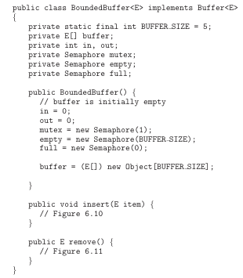
Bounded-Buffer Problem

Slide 36
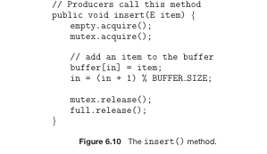
Bounded-Buffer insert()

Slide 37
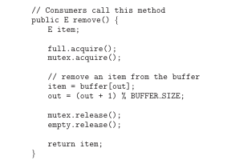
Bounded-buffer remove()

Slide 38
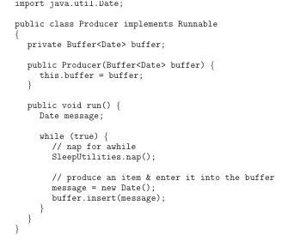
Bounded-buffer producer

Slide 39
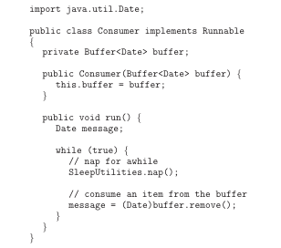
Bounded-buffer consumer

Slide 40
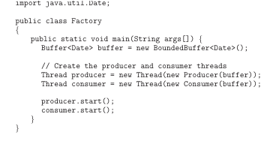
Bounded-buffer factory

Slide 41
Readers-Writers Problem
A data set is shared among a number of concurrent processes
  Readers – only read the data set; they do not perform any updates
  Writers – can both read and write
Problem – allow multiple readers to read at the same time. Only one single writer can access the shared data at the same time
Shared Data
  Data set
  Semaphore mutex initialized to 1
  Semaphore db initialized to 1
  Integer readerCount initialized to 0

Slide 42

Readers-Writers Problem
Interface for read-write locks

Slide 43
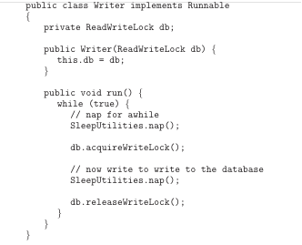
Readers-Writers Problem (Cont.)
The structure of a writer

Slide 44
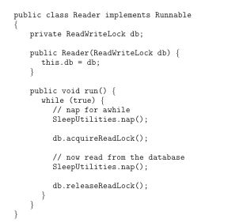
Readers-Writers Problem (Cont.)
The structure of a reader

Slide 45
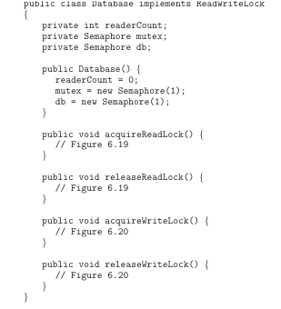
Readers-Writers Problem (Cont.)
The database

Slide 46
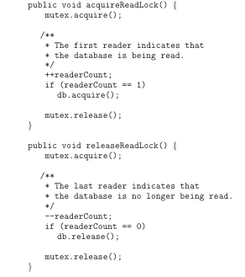
Readers-Writers Problem (Cont.)
Reader methods

Slide 47
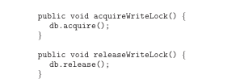
Readers-Writers Problem (Cont.)
Writer methods

Slide 48
Problems with Semaphores
Correct use of semaphore operations:
  Correct ➔ mutex.acquire() …. mutex.release()
  Incorrect ➔ mutex.acquire () or mutex.release() (or both)
  Omitting either mutex.acquire() or mutex.release()

Slide 49
Monitors
A high-level abstraction that provides a convenient and effective mechanism for process synchronization
Only one process may be active within the monitor at a time

Slide 50
Monitors
Programming language construct that supports controlled access to shared data
  Compiler adds synchronization automatically
  Enforced at runtime
Encapsulates
  Shared data structures
  Procedures/functions that operate on the data
  Synchronization between processes calling those procedures
Only one process active inside a monitor at any instant
  All procedures are part of critical section
Hoare, C.A.R., “Monitors: An Operating System Structuring Concept,” Communications of ACM, vol. 17, pp. 549-557, Oct. 1974 (.pdf, correction)

Slide 51
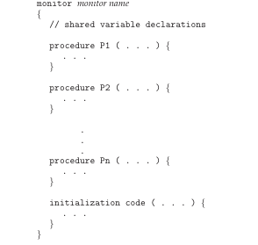
Syntax of a Monitor

Slide 52

Schematic view of a Monitor

Slide 53
Condition Variables
Condition x, y;
Two operations on a condition variable:
  x.wait () – a process that invokes the operation is
  suspended
  x.signal () – resumes one of processes (if any) that
  invoked x.wait ()

Slide 54

Monitor with Condition Variables

Slide 55
Monitors
High-level synchronization allowing safe sharing of an abstract data type among concurrent processes.
monitor monitor-name
{
shared variable declarations
procedure body P1 (…) {
. . .
}
procedure body P2 (…) {
. . .
}
procedure body Pn (…) {
. . .
}
{
initialization code
}
}

Slide 56
Monitors
Mutual exclusion
  only one process can be executing inside at any time
  if a second process tries to enter a monitor procedure, it blocks until the first has relinquished the monitor
Once inside a monitor, process may discover it is not able to continue
condition variables provided within monitor
    processes can wait or signal others to continue
    condition variable can only be accessed from inside monitor
    wait’ing process relinquishes monitor temporarily

Slide 57
Monitors
To allow a process to wait within the monitor, a condition variable must be declared, as
condition x;
Condition variable can only be used with the operations wait and signal.
  The operation
  wait(x);
  means that the process invoking this operation is suspended until another process invokes
  signal(x);
  The signal operation resumes exactly one suspended process. If no process is suspended, then the signal operation has no effect.

Slide 58
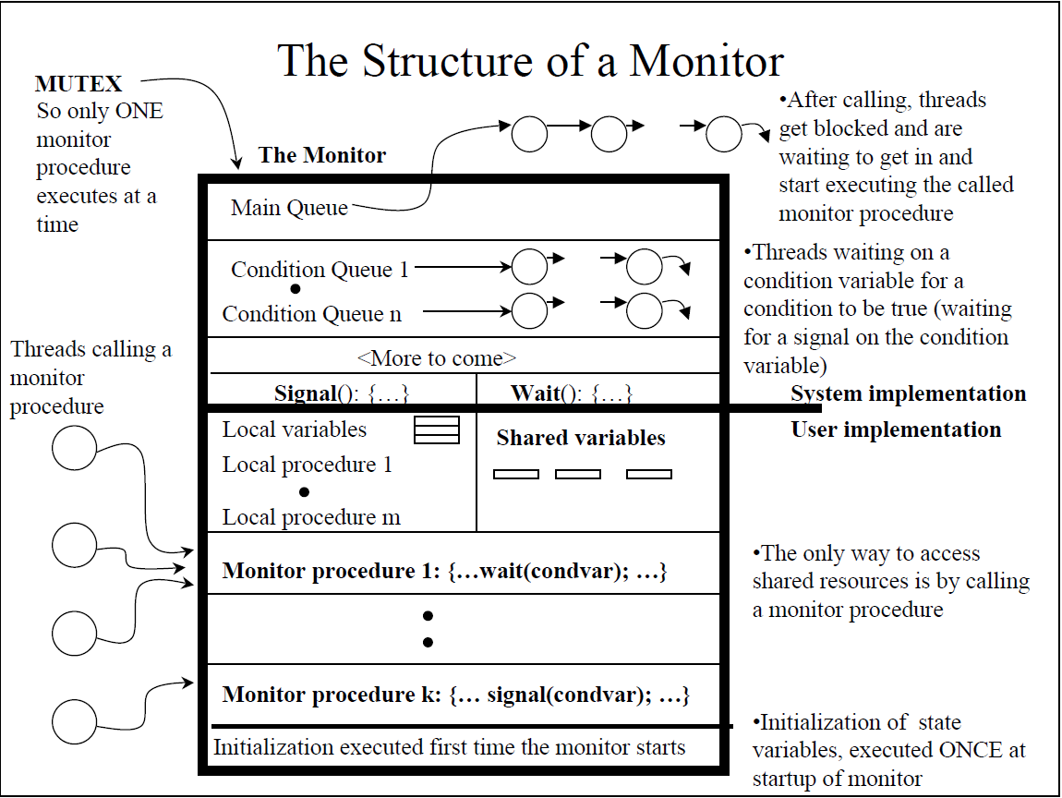

Slide 59
Monitors
Monitors represent the logic of the program
  Wait if necessary
  Signal when change something so any waiting threads can proceed
Basic structure of monitor-based program:
  lock
  while (need to wait) {
  unlock
  condvar.wait();
  lock
  }
  do something so no need to wait
  condvar.signal();
  unlock
Check and/or update
state variables
Wait if necessary
Check and/or update
state variables

Slide 60
Review: Motivation for Monitors and Condition Variables
Semaphores are a huge step up, but:
  They are confusing because they are dual purpose:
    Both mutual exclusion and scheduling constraints
    Example: the fact that flipping of P’s in bounded buffer gives deadlock is not immediately obvious
  Cleaner idea: Use locks for mutual exclusion and condition variables for scheduling constraints
Definition: Monitor: a lock and zero or more condition variables for managing concurrent access to shared data
  Use of Monitors is a programming paradigm
  Some languages like Java provide monitors in the language
The lock provides mutual exclusion to shared data:
  Always acquire before accessing shared data structure
  Always release after finishing with shared data
  Lock initially free

Slide 61
Condition Variables
How do we change the get() routine to wait until something is in buffer?
  Could do this by keeping a count of the number of things on the queue (with semaphores), but error prone
Condition Variable: a queue of threads waiting for something inside a critical section
  Key idea: allow sleeping inside critical section by atomically releasing lock at time we go to sleep
  Contrast to semaphores: Can’t wait inside critical section
Operations:
  Wait(&lock): Atomically release lock and go to sleep. Re-acquire lock later, before returning.
  Signal(): Wake up one waiter, if any
  Broadcast(): Wake up all waiters
Rule: Must hold lock when doing condition variable ops!

Slide 62
Producer Consumer using Monitors
Monitor Producer_Consumer {
any_t buf[N];
int n = 0, tail = 0, head = 0;
condition not_empty, not_full;
void put(char ch) {
while(n == N)
wait(not_full);
buf[head%N] = ch;
head++;
n++;
signal(not_empty);
}
char get() {
while(n == 0)
wait(not_empty);
ch = buf[tail%N];
tail++;
n--;
signal(not_full);
return ch;
}

Slide 63
Reminders: Subtle aspects
Notice that when a thread calls wait(), if it blocks it also automatically releases the monitor’s mutual exclusion lock
This is an elegant solution to an issue seen with semaphores
  Caller has mutual exclusion and wants to call P(not_empty)… but this call might block
  If we just do the call, the solution deadlocks…
  But if we first call V(mutex), we get a race condition!

Slide 64

Solution Explanation
A reader can enter if
  There are no writers active or waiting
So we can have many readers active all at once
Otherwise, a reader waits (maybe many do)
When a writer finishes, it checks to see if any readers are waiting
  If so, it lets one of them enter
  That one will let the next one enter, etc…
Similarly, when a reader finishes, if it was the last reader, it lets a writer in (if any is there)
It wants to be fair
  If a writer is waiting, readers queue up
  If a reader (or another writer) is active or waiting, writers queue up
  this is mostly fair, although once it lets a reader in, it lets ALL waiting readers in all at once, even if some showed up “after” other waiting writers

Slide 65
Dining Philosopher Problem
Dining Philosophers. There is a dining room containing a circular table with five chairs. At each chair is a plate, and between each plate is a single chopstick. In the middle of the table is a bowl of spaghetti. Near the room are five philosophers who spend most of their time thinking, but who occasionally get hungry and need to eat so they can think some more.
In order to eat, a philosopher must sit at the table, pick up the two chopsticks to the left and right of a plate, then serve and eat the spaghetti on the plate.

Slide 66
Two issues
  Starvation
  Deadlock
What can be the solution
A waiter as a mediator (semaphore)
  Who decides for the fork allocation

Slide 67
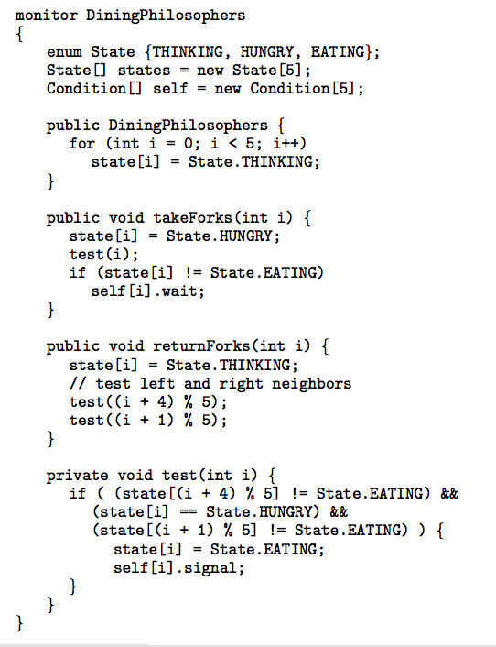
Solution to Dining Philosophers

Slide 68
Solution to Dining Philosophers (Cont.)
Each philosopher I invokes the operations takeForks(i) and returnForks(i) in the following sequence:
dp.takeForks (i)
EAT
dp.returnForks (i)

Slide 69
Java Synchronization
Java provides synchronization at the language-level.
Each Java object has an associated lock.
This lock is acquired by invoking a synchronized method.
This lock is released when exiting the synchronized method.
Threads waiting to acquire the object lock are placed in the entry set for the object lock.

Slide 70
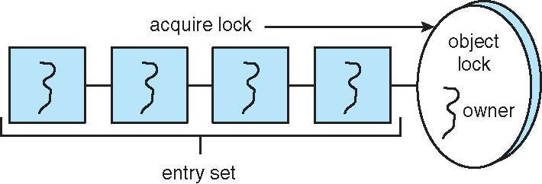
Java Synchronization
Each object has an associated entry set.

Slide 71
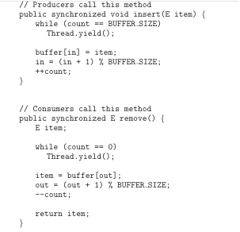
Java Synchronization
Synchronized insert() and remove() methods – Incorrect!

Slide 72
Java Synchronization wait/notify()
When a thread invokes wait():
1. The thread releases the object lock;
2. The state of the thread is set to Blocked;
3. The thread is placed in the wait set for the object.
When a thread invokes notify():
1. An arbitrary thread T from the wait set is selected;
2. T is moved from the wait to the entry set;
3. The state of T is set to Runnable.

Slide 73
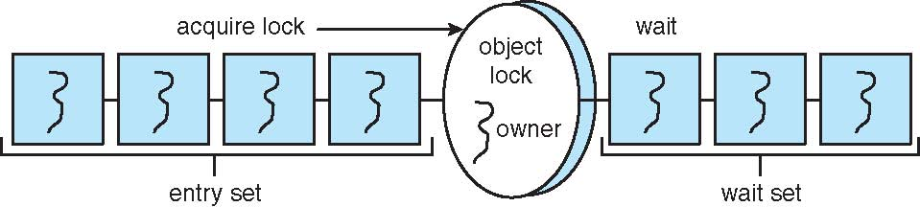
Java Synchronization
Entry and wait sets

Slide 74
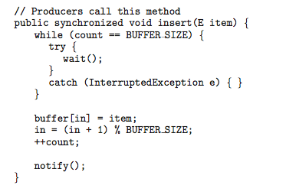
Java Synchronization – wait/notify
Synchronized insert() method – Correct!

Slide 75
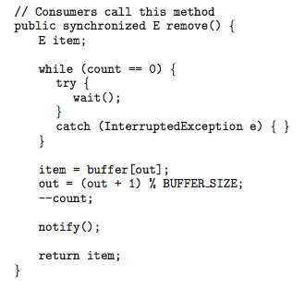
Java Synchronization – wait/notify
Synchronized remove() method – Correct!

Slide 76
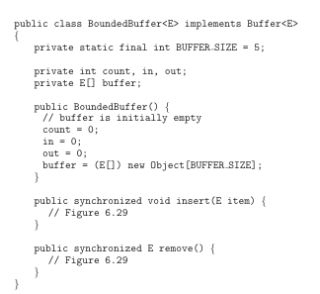
Java Synchronization - Bounded Buffer

Slide 77
Java Synchronization
The call to notify() selects an aribitrary thread from the wait set. It is possible the selected thread is in fact not waiting upon the condition for which it was notified.
The call notifyAll() selects all threads in the wait set and moves them to the entry set.
In general, notifyAll() is a more conservative strategy than notify().

Slide 78
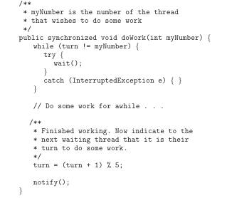
Java Synchronization
notify() may not notify the correct thread!

Slide 79
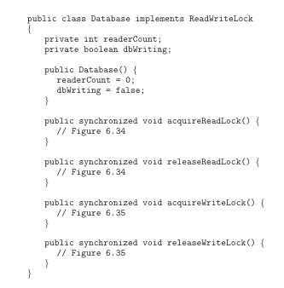
Java Synchronization - Readers-Writers

Slide 80
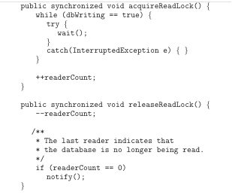
Java Synchronization - Readers-Writers
Methods called by readers

Slide 81
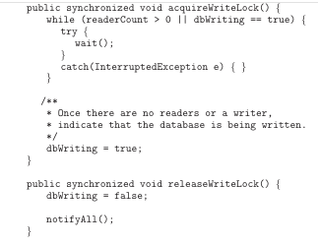
Java Synchronization - Readers-Writers
Methods called by writers

Slide 82
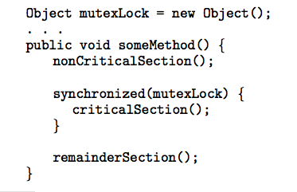
Java Synchronization
Rather than synchronizing an entire method, Block
synchronization allows blocks of code to be declared as
synchronized

Slide 83
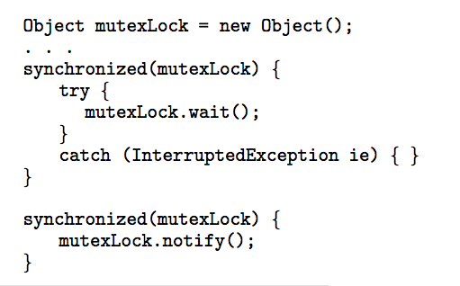
Java Synchronization
Block synchronization using wait()/notify()

Slide 84
Concurrency Features in Java 5
Prior to Java 5, the only concurrency features in Java were Using synchronized/wait/notify.
Beginning with Java 5, new features were added to the API:
Reentrant Locks
Semaphores
Condition Variables

Slide 85
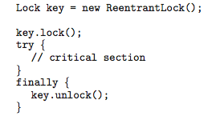
Concurrency Features in Java 5
Reentrant Locks

Slide 86
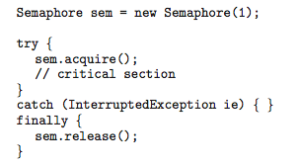
Concurrency Features in Java 5
Semaphores

Slide 87

Concurrency Features in Java 5
A condition variable is created by first creating a
ReentrantLock and invoking its newCondition() method:
Once this is done, it is possible to invoke the
await() and signal() methods

Slide 88
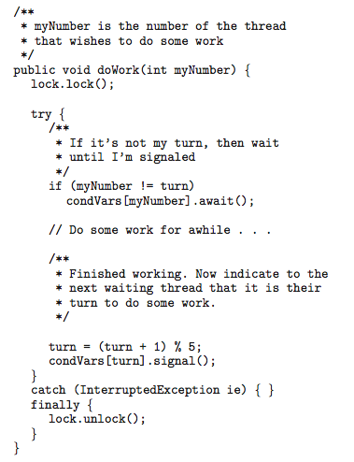
Concurrency Features in Java 5
doWork() method with condition variables

Slide 89
Synchronization Examples
Solaris
Windows XP
Linux
Pthreads

Slide 90
Solaris Synchronization
Implements a variety of locks to support multitasking, multithreading (including real-time threads), and multiprocessing
Uses adaptive mutexes for efficiency when protecting data from short code segments
Uses condition variables and readers-writers locks when longer sections of code need access to data
Uses turnstiles to order the list of threads waiting to acquire either an adaptive mutex or reader-writer lock

Slide 91
Windows XP Synchronization
Uses interrupt masks to protect access to global resources on uniprocessor systems
Uses spinlocks on multiprocessor systems
Also provides dispatcher objects which may act as either mutexes and semaphores
Dispatcher objects may also provide events
  An event acts much like a condition variable

Slide 92
Linux Synchronization
Linux:
  Prior to kernel Version 2.6, disables interrupts to implement short critical sections
  Version 2.6 and later, fully preemptive
Linux provides:
  semaphores
  spin locks

Slide 93
Pthreads Synchronization
Pthreads API is OS-independent
It provides:
  mutex locks
  condition variables
Non-portable extensions include:
  read-write locks
  spin locks

